Slide 1
WORLD OF DRONE
Drone Application: Cargo

Slide 2
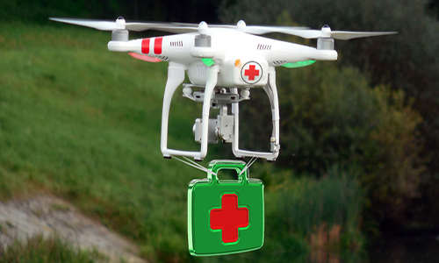
Drone Application: Cargo
UAVs can transport medicines and medical specimens into and out of inaccessible regions.

Slide 3
Drone Application: Cargo
In 2014, the prime minister of the United Arab Emirates announced that the UAE planned to launch a fleet of UAVs to deliver official documents and supply emergency services at accidents.

